Slide 1
HISTORY OF PALLIATIVE CARE
Iyekat Hellen
Education Site Coordinator
Mobile Hospice Mbarara

Slide 2
Introduction
This session will
provide a background understanding of the philosophy of palliative care,
discuss its origins in Africa.
And emphasize the hospice concept.

Slide 3
Session Objectives
By the end of this session, participants should be able to:
Describe the concept of Hospice
Define palliative care
Explain the scope and nature of palliative care

Slide 4
Hospice Concept
Hospice originates from ‘Hospes’ (Greek) and ‘Hospitium’ (Latin) which means hospitality.
Modern hospice movement looks at hospice as a philosophy of care
Patients and their families are ‘guests and:-
Are encouraged to participate in discussions and make treatment and management choices.

Slide 5
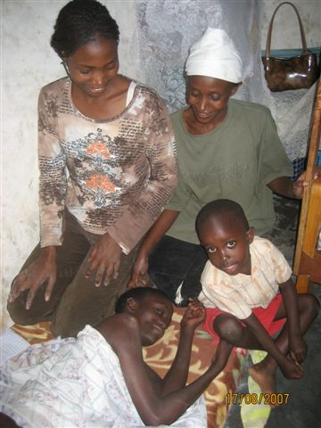
PATIENT AND FAMILY CENTRE OF CARE

Slide 6
Hospice Concept contd
Hospice is not a building but rather a concept.
Dame Cicely Saunders (RIP 2005) found the modern hospice in 1967
Set up the first modern hospice at St. Christopher's Hospice in London.
Hospice emphasises palliative :
Rather than curative treatment;
Quality rather than quantity of life.

Slide 7
WHO definition of palliative care
Palliative care is an approach that improves the quality of life of patients and their families facing the problem associated with life-threatening illness, through the prevention and relief of suffering by means of early identification and impeccable assessment and treatment of pain and other problems, physical, psychosocial and spiritual (holistic approach)
(WHO 2002)

Slide 8
Palliative Care
provides relief from pain and other distressing symptoms;
affirms life and regards dying as a normal process;
intends neither to hasten nor postpone death;
integrates the psychological and spiritual aspects of patient care;
offers a support system to help patients live as actively as possible until death;

Slide 9
Palliative care
PC is applicable early in the course of illness, in conjunction with other therapies that are intended to improve life, such as chemotherapy or radiation therapy, and includes those investigations needed to better understand and manage distressing clinical complications. World Health Organization (WHO) Definition of Palliative Care (2002)

Slide 10
continued
offers a support system to help the family cope during the patients illness and in their own bereavement;
uses a team approach to address the needs of patients and their families, including bereavement counselling, if indicated;
will enhance quality of life, and may also positively influence the course of illness;

Slide 11
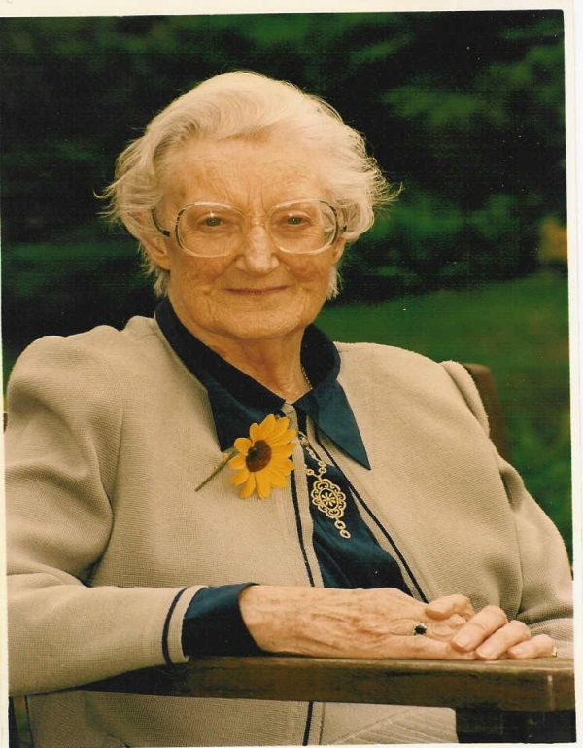
Quotation from Dame Cicely
You matter because you are YOU
You matter up to the last moment of your life
And we will do all that we can to help you
To LIVE until you die”

Slide 12
Origins of PC in Africa
1979-Zimbabwe: Island hospice
1980: S Africa: St Lukes’ Cape town: Chris Dare
1990: Nairobi Hospice was the first Hospice designed, from inception, for the needs of Africans The third country with PC including oral morphine

Slide 13
Origins of PC in Africa
1993: Hospice Africa Uganda
1994: Sierra Leone (no morphine)
1994: Swaziland, Zambia, Botswana
2000: Tanzania
2001: Malawi
2006: Nigeria, Cameroon, Ghana

Slide 14
PRINCIPLES OF PALLIATIVE CARE

Slide 15
Session Objectives
By the end of the session, participants should be able to:
Discuss the principles of palliative care
Discuss the public health approach to palliative care and analyse its appropriateness in different contexts
Describe the roles of a multi professional team in palliative care.

Slide 16
Introduction
For effective patient care a number of principles have to be put into consideration.
These principles act as a guide to achieving good medical practice

Slide 17
Activity 1: Understanding the principles of Palliative Care
A list of principles of Palliative care will be presented to participants
Participants, working in groups of six will discuss the principles.
Each group may discuss one or two principles. Groups will present in plenary

Slide 18
Discussion points
Principles of palliative care include:
Holistic approach
patient centred care
teamwork and partnership,
involve and support family
appropriate ethical considerations and continuum of care.

Slide 19
1) Holistic Approach
Carrying out a comprehensive assessment and addressing problems holistically.
Holistic Care:
All 4 aspects that make up the whole person need to be addresse
Physical Spiritual
Psychological Social

Slide 20
Patient Centred Care
Palliative care advocates that the patient be the ‘centre of care’.
Care should focus around the patient’s wishes, this means in practice that the patient should be treated with respect and involved in any decision making about their care and treatment options.

Slide 21
(3) Teamwork and partnership
Establishing multi-disciplinary teams to provide support to patients and families is more effective.
Team members help to share and support each other. No single professional can adequately address all the issues arising from a life limiting illness.
Constant exposure to patient’s distressing circumstances can be emotionally draining on staff members.

Slide 22
In groups of three Identify members of the holistic care team
One member share with the rest of the team
Facilitator notes on the flip chart

Slide 23
The team may consist of the following members:
Patient and family
Doctors
nurses
clinical Officers
social Workers
physiotherapist / occupational therapies volunteers
spiritual advisors
support staff.

Slide 24
Team work and partnership
Regular team meetings
case conferences
educational sessions and
informal interactions
Result into support and growth of the team members.

Slide 25
(4) Family involvement and support
Consider family opinions when formulating a plan of management.
This is vital as the family gives continued social support and care.

Slide 26
(5) Appropriate ethical considerations
Work within the four pillars of medical ethics:
Beneficence - Do good
Non Maleficence - Do no harm
Autonomy - Patients right to decide
Justice - Fairness

Slide 27
6) Continuum of Care
Involves a network of resources and services that provide holistic care for ill persons and family care givers.
Its services range from home to community agencies and from clinics to hospitals and vice versa.
It ensures continuity of care.
Palliative care is therefore a continuum of care into
which the patient and their family may enter at
any point.

Slide 28
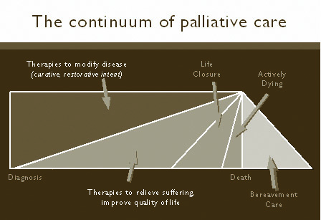

Slide 29
The public health approach to palliative care
Palliative care has moved on from its
initial association with cancer to
encompass HIV/AIDS, the pandemic
that is currently ravaging Sub-Saharan
Africa.

Slide 30
The diagram below represents the
three foundation measures for
implementing pain relief programmes
as recommended by WHO (1986)

Slide 31
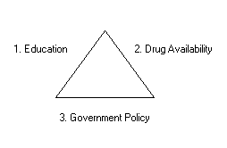

Slide 32
1. EDUCATION:
Palliative care education is appropriate for the following cadres since it is a new specialty.
Specialist nurses /clinical officers and doctors in palliative care – ready to pass their knowledge and skills to others
All Health professionals

Slide 33
1. EDUCATION:
Others: Allied professionals, patients
and their families, non-health
professionals, local leaders, trusted
confidantes, local spiritual leaders,
traditional health practitioners (THP)
and Traditional Birth Attendants (TBAs).

Slide 34
2.
For pain and symptom control, a limited number of inexpensive drugs need to be available.
Oral morphine is the recommended drug of choice for the control of severe pain. However, it is not widely available and accessible to the majority who need it, especially in the developing world including Africa.

Slide 35
DRUG AVAILABILITY:
This is because of excessive regulation by the various national governments regarding addiction to opioids.

Slide 36
2. DRUG AVAILABILITY:
Health professionals need to be
trained in pain assessment, and
management, especially with the aid
of the WHO 3 step analgesic ladder
(details will be discussed under pain
management).

Slide 37
2. DRUG AVAILABILITY:
The various national governments
have therefore been asked to check
and review the policies that lead to
scarcity of these drugs, especially oral
morphine.

Slide 38
There is an urgent need for governments to establish the legal and administrative frameworks that would ease the control of opioid analgesics and make them available for medical use according to International Treaties and recommendations of International narcotic control board (INCB) and WHO (details will be discussed under Laws governing the use of morphine

Slide 39
3. GOVERNMENT POLICY:
The government must draw up a comprehensive policy on palliative care incorporating the service, education and drug availability aspects.
Uganda has been quick in responding to the huge palliative care needs in the community by making palliative care services one of the essential health needs.
Palliative Care in Uganda is now one of the priorities on the 5 year Health Sector Strategic Plan.

Slide 40
The roles of the multidisciplinary team
Although there are different members in the team, some of the members may play multiple roles depending on the need and/or organization.

Slide 41
TEAM MEMBER | ROLE IN TEAM
Patient and family | Most important member of the team, active participation in all decision making and planning, to be treated with dignity, empathy & respect
Doctor | Plays a central role in pain and symptom control, medical assessment and supervision, medical treatment, team training and support, diagnosis of illness, prescribe medication, refer to specialist
Nurse | Physical care of patient, help patient cope with advancing disease, observe what brings relief and comfort, supervise home based care givers, train and support team

Slide 42
TEAM MEMBER | ROLE IN TEAM
Psychologist | Specialized grief and bereavement counseling, training and support,
Social worker | Instrumental support: referral to community resources, poverty relief, discharge planning, liaison with community. Emotional support: counseling (individual, family, grief and bereavement) Train and support team, care of caregiver
Spiritual caregiver | spiritual support

Slide 43
TEAM MEMBER | ROLE IN TEAM
Volunteer | Support the teams as required
Educators | Teach patient and family

Slide 44
TEAM MEMBER | ROLE IN TEAM
Caregivers | Primary hands on care of patients, psychosocial support
Dietician/Nutritionist | Attend to specific nutritional requirements of patients. HIV/AIDS- far greater nutritional needs
Other professionals dentist, Physiotherapist Occupational and others | Unique requirements and needs of each patient should be addressed by relevant profession or therapist

Slide 45
Summary of Key points
Hospice is a concept not a building
Palliative care is a holistic approach of care
The patient and family are at the centre of care

Slide 46
Summary of key points
Embrace holistic care for patients and their families.
Ensure continuity of care
For palliative care to be effective the three WHO foundation measures should be in place
Team members play different roles however some team members may play multiple roles

Slide 47
Review of session Objectives
By the end of the session, participants should be able to:
Discuss the principles of palliative care
Discuss the public health approach to palliative care and analyse its appropriateness in different contexts
Describe the roles of a multi professional team in palliative care.

Slide 48
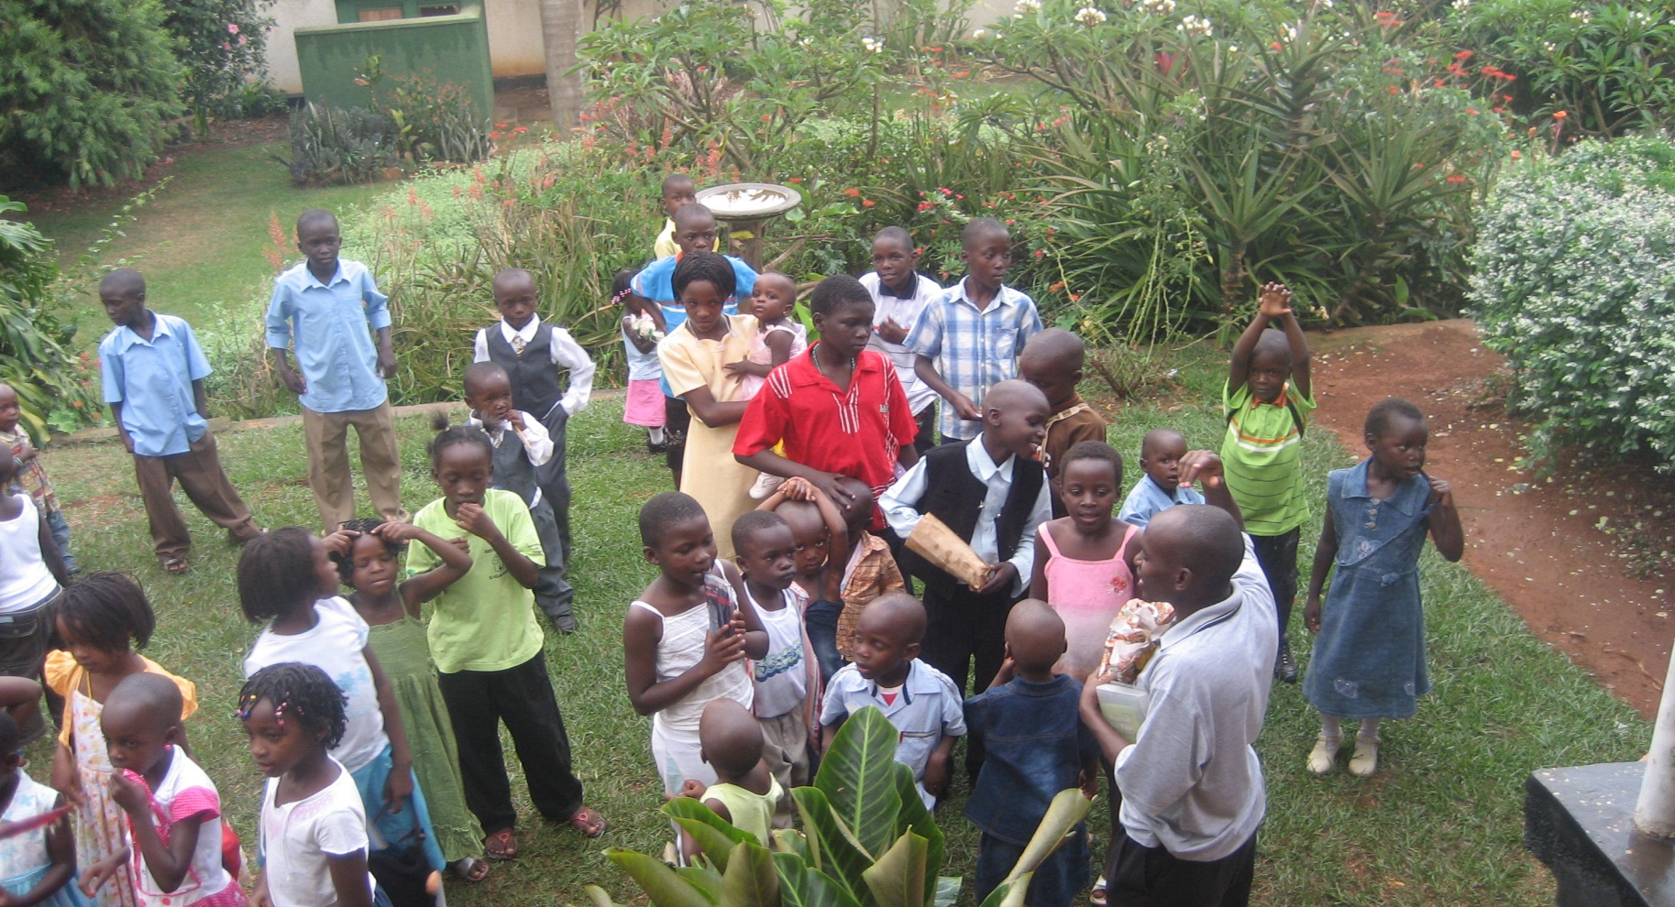
Any Questions??

